Slide 1



Comparing Popularity of Venues in New York City Neighborhoods Affected by COVID-19
By: Taylor Flowers

Slide 2
Introduction: Business Problem
New York City has been heavily impacted by COVID-19.
Over 220,000 cases
Over 18,000 confirmed deaths
Over 4,000 probable deaths
As the city reopens and economic activity increases, prospective business owners are curious which venues are most popular in NYC neighborhoods affected by COVID-19.
We will provide suggestions

Slide 3
Data
NYC Covid Data
ZCTA Census Data
Foursquare Location Data

Slide 4
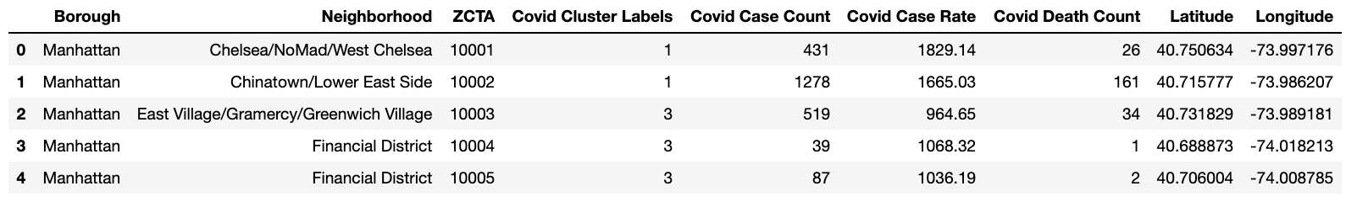

Slide 5
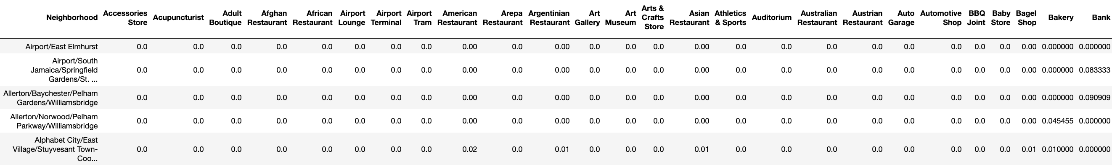

Slide 6
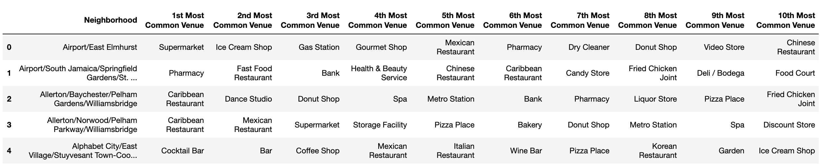

Slide 7
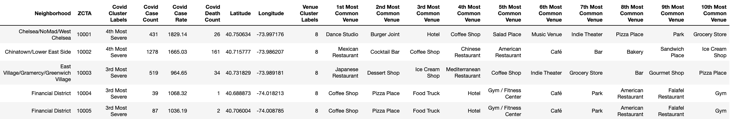

Slide 8

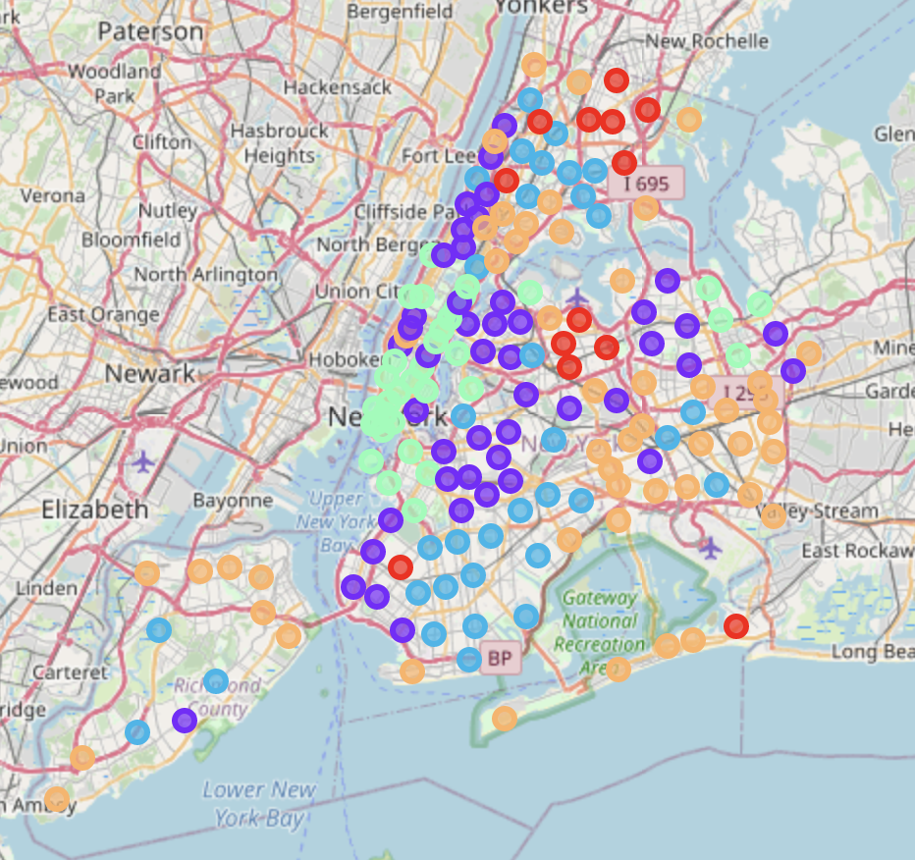
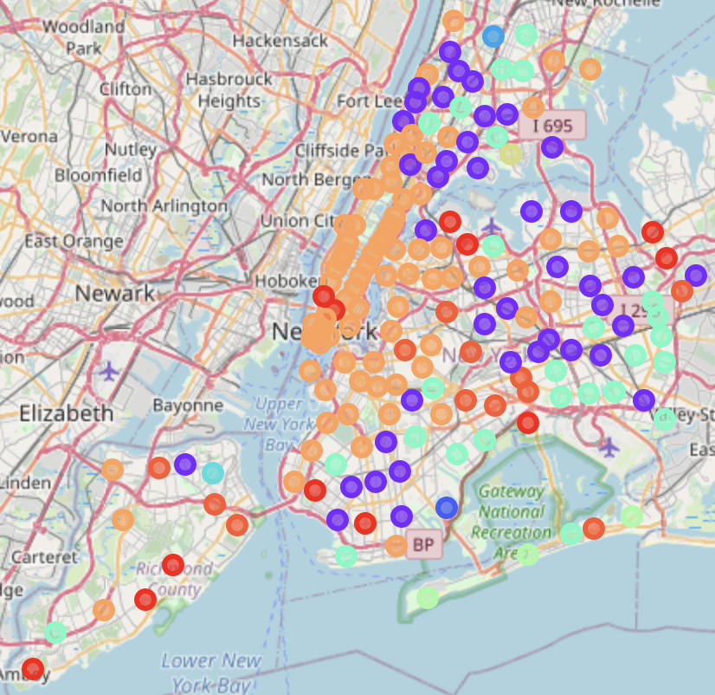
Cluster Map Visualizations
COVID Prevalence Clusters
Venue Popularity Clusters

Slide 9
